Slide 1
AP-XPS & application in surface science
2020.11.11
第三组
田枢衡、曹若辰、张欣睿、朱凯煜、吉恬萌、唐靖霖

Slide 2
CONTENTs
Introduction
Basic theory of XPS
AP-XPS and its instruments composition
Applications in surface science
Summary

Slide 3
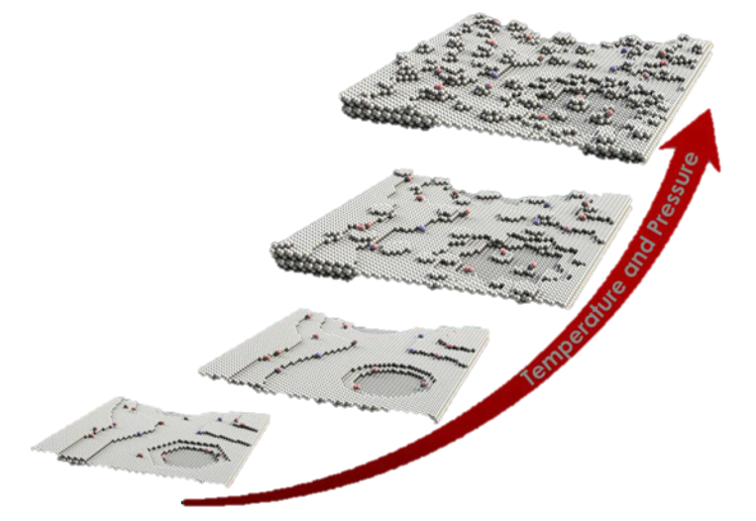
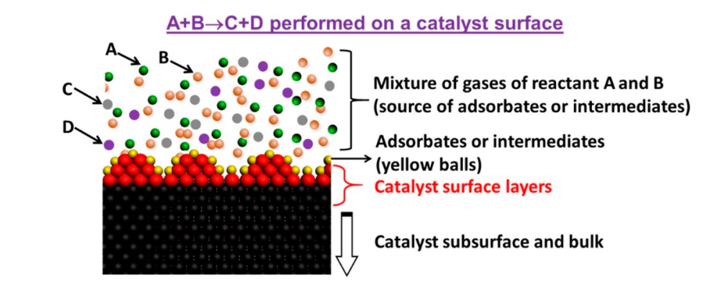
Introduction
(N)AP-XPS:
Near ambient pressure X-ray photoelectron spectroscopy
~1 mbar，operando / in situ experiment
True states (electronic states) during reactions
Detecting adsorbates or intermediates
Coupled with MS (Mass spectrometry) to observe reactions
Detect reactants on the surface
Surface changes with T and P
Notes:
对催化剂结构和反应的把控往往难以同步进行
具有完美晶型的材料不一定具有好的催化反应活性，相反的有缺陷的材料才是催化反应活性位，

Slide 4
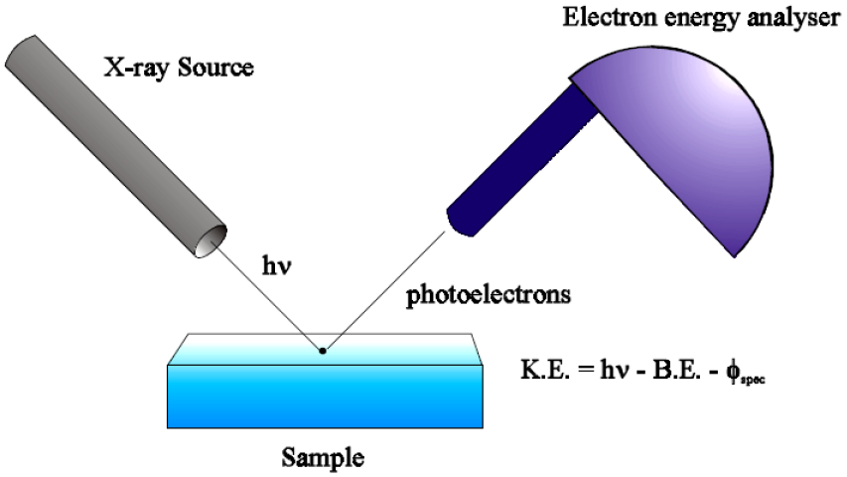
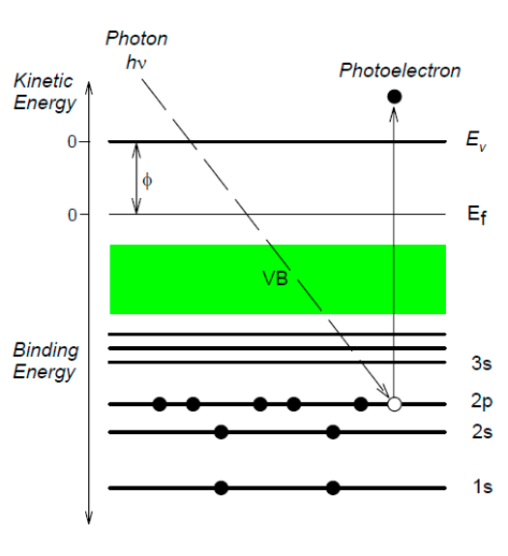
Basic theory of XPS
A brief vision:
Photoelectric effect
Main applications:
Measuring the binding energy (B. E.)
B. E. =0 when E_{core} = E_{F}
Monitoring the changes of chemical state of surface atoms
B. E. changes when electronic density changes (energy level / valence changes)
Why surface?
The mean free path of electrons
λ < 10 nm, depend on K. E. & materials
Notes:
常压XPS在实际的科研中可以用来检测表面原子在特定气氛下的化学状态改变。这里首先给大家介绍一个大致的物理图象，在材料中，通常形成价带的是外层电子，而内层电子处于原子核附近的分立能级中，当原子的电子密度增加时，受到电子排斥的影响，原子的能级会上升，相应的结合能就会减小；当原子的电子密度减小时，电子的排斥作用会减弱，原子的能级会下降，相应的结合能会增加。因而从结合能的变化，我们就可以判断出原子电子密度的改变方向。

Slide 5
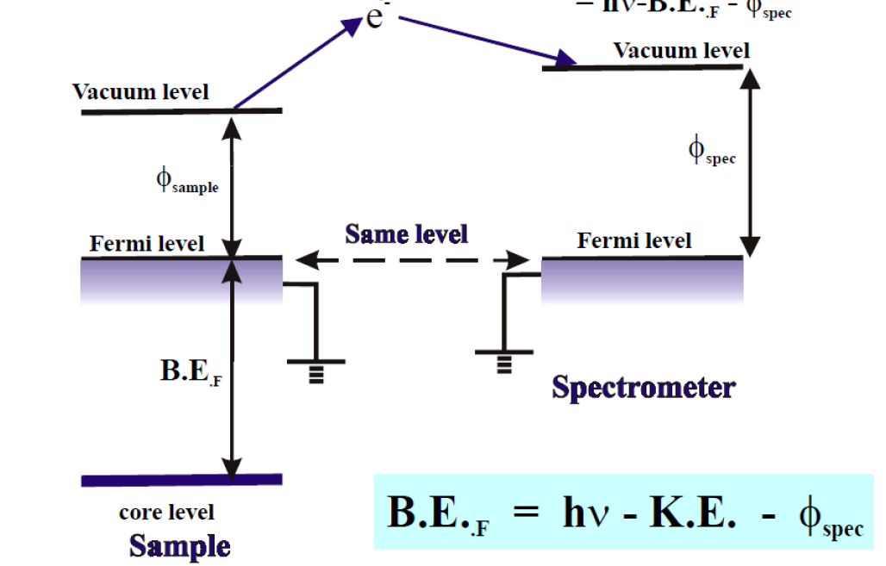
Basic theory of XPS
Work function calibration:
Independent of work function of samples
Decided by work function of spectrometer (calibrated by standard Ag / Au)

Slide 6
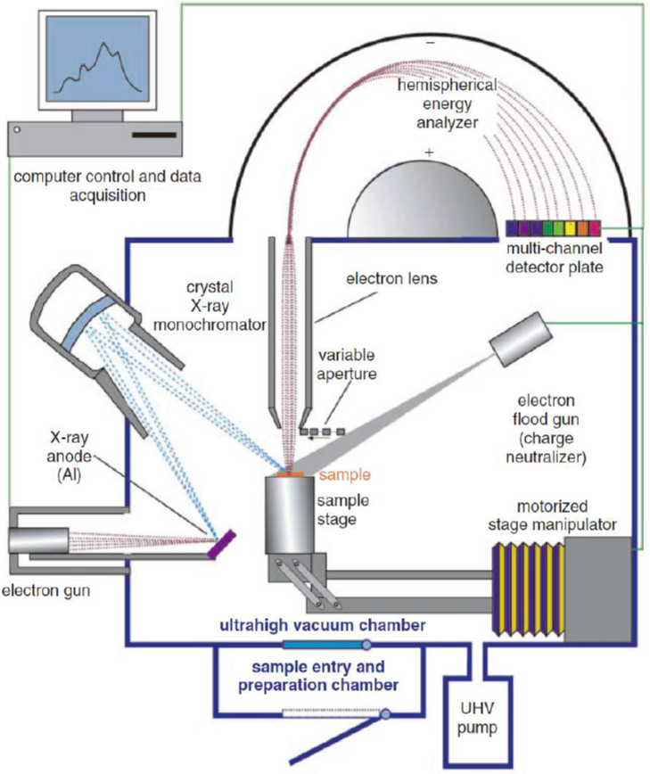
Basic theory of XPS
Instruments:
X-ray source:
Al (1486.6eV) or Mg (1253.6eV)
UHV:
No gas, pressure < 10⁻⁸ mbar
All components in one UHV system
Advantages:
Easy to test
Disadvantages:
Unable to introduce gases
Unable to change hv
X. Bao, Chem. Rev., 2019, 119, 12, 6822-6905

Slide 7
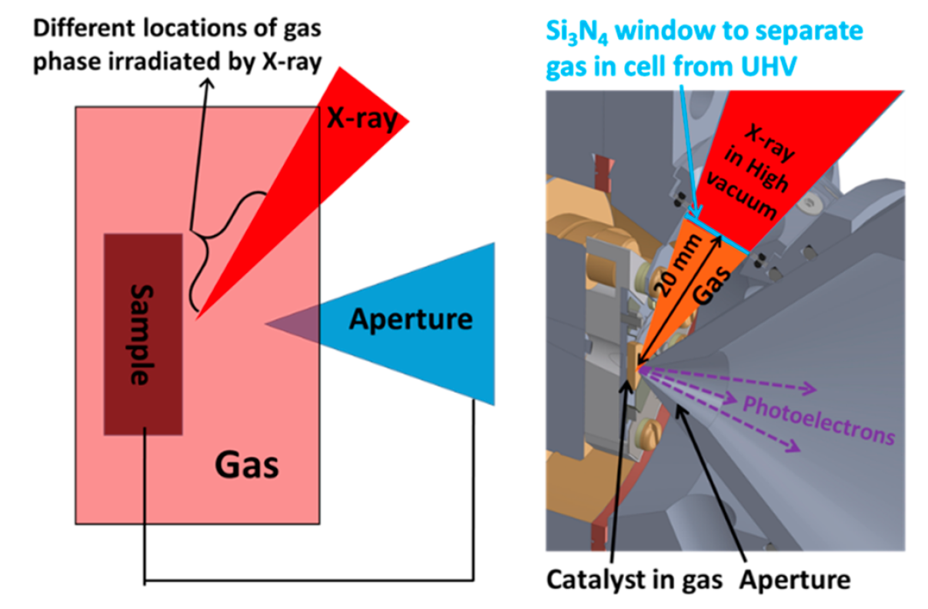
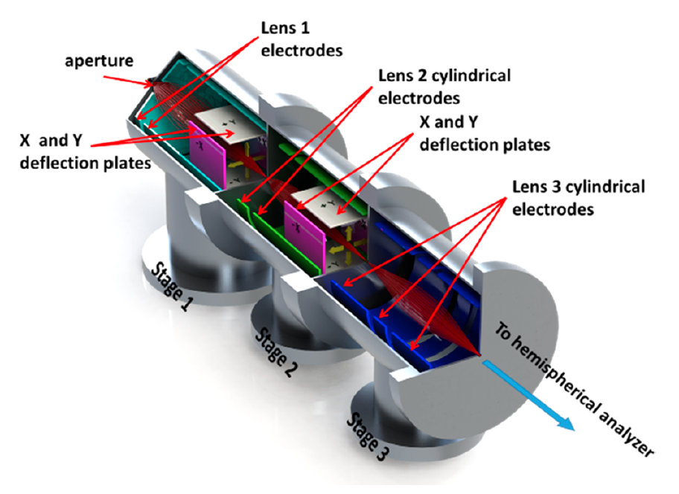
AP-XPS and its instruments composition
Experiment conditions:
Near ambient pressure: ~1mbar
X-ray：
Synchrotron radiation:
Higher light intensity, monochromaticity, energy adjustable (control detecting depth)
Normal light source:
Al or Mg, requiring higher light intensity
Instruments composition:
Vacuum system: differential pumping system
Analyzer and its structure / position

Slide 8
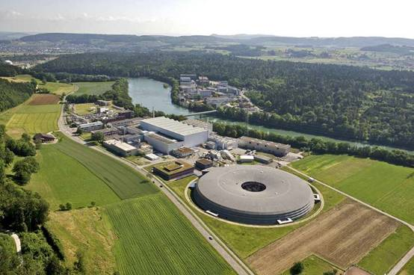
AP-XPS and its instruments composition——SLS in PSI
Swiss Light Source
Aperture
Sample
Analyzer
Pumps

Slide 9
Reaction chamber
In situ cell: gas flow up to down, ~1 mbar
IR-heated: control temperature from 20 to 1000 ℃
Si₃N₄ window: separate X-ray and in situ cell
Aperture: ~1 mm, close to sample, allow photoelectrons to enter
When photoelectrons entering, the vacuum system guarantees the signal quality.

Slide 10
Vacuum system
Second stage
First stage
Differential pumping system
Bypass value is connected with UHV, making it easy to control the pressure from 1 mbar to 5 x 10⁻⁷ mbar

Slide 11
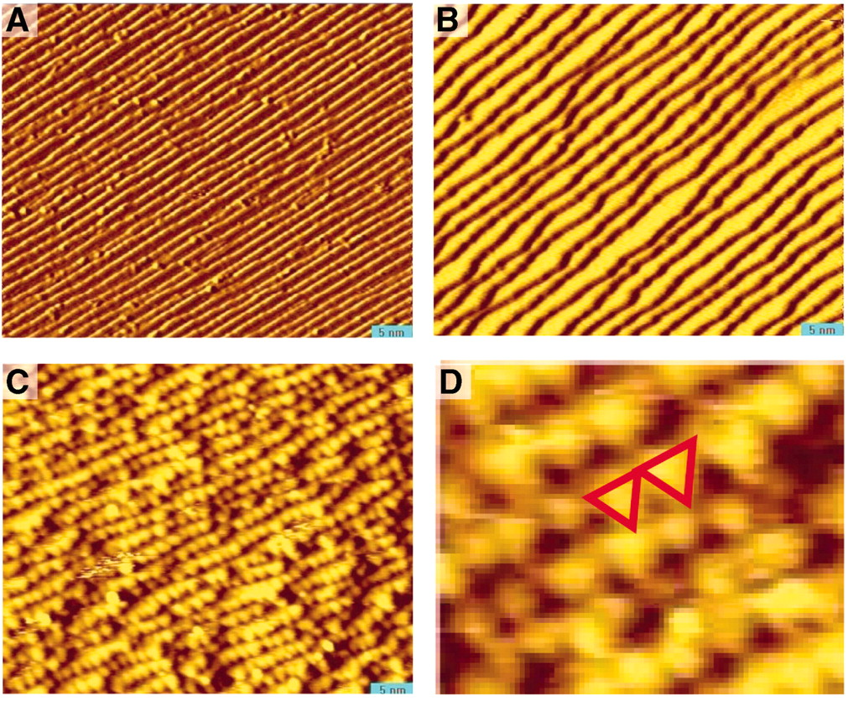
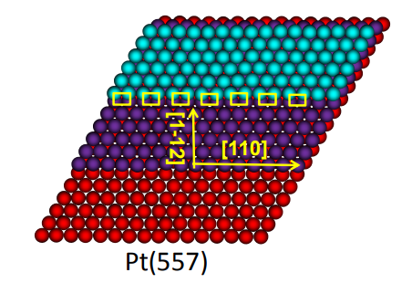
Applications
Reversible surface reconstruction caused by adsorbates：Pt(557) CO
STM of Pt (557) ： ascending CO pressure
UHV(10⁻¹⁰ Torr)
5×10⁻⁸ Torr
1 Torr CO
12 Å terrace width
26 Å terrace width
cluster
Feng Tao et al, Science, 2010, 327, 850-853

Slide 12
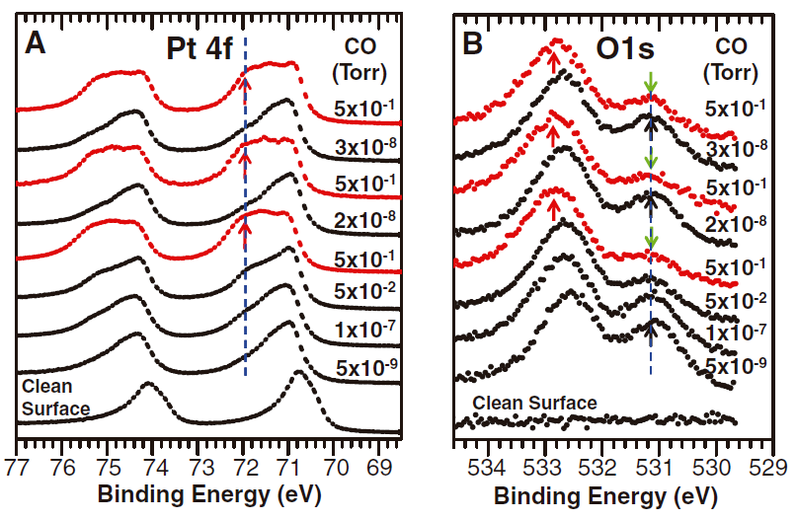
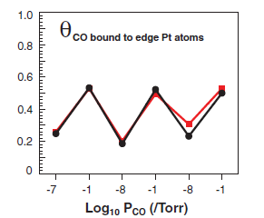
Applications
AP-XPS in different CO pressure：
low CN
top
bridge
top
bridge
Pt 4f: High CO pressure results in more Pt with low coordinate number(CN), corresponding to Pt on edge of clusters.
O 1s: High CO pressure results in shift of top sites CO, corresponding to CO bound to edge Pt.
Notes:
A中标记位置为低配位数的Pt，正电性增强，低配位数，对应cluster

Slide 13
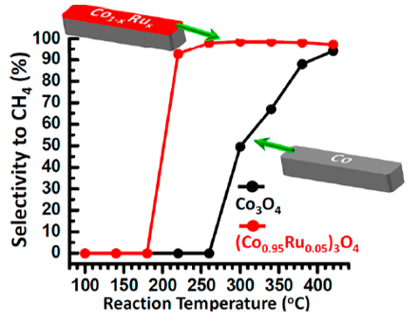
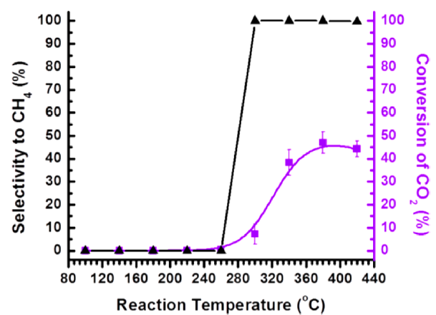
Applications
Co-Ru bimetallic surface for CO₂ reduction:
CO₂ + H₂ → CH₄ + H₂O
Ru/SiO₂
（inert carrier）
Co-Ru bimetallic catalyst has a much lower light-off temperature (180℃) than Co₃O₄ or Ru (260℃) and better catalytic activity.
AP-XPS shows the consistency of Co oxidation state change and light-off temperature.
Yuan Zhu. ACS Catal. 2012, 2, 2403−2408

Slide 14
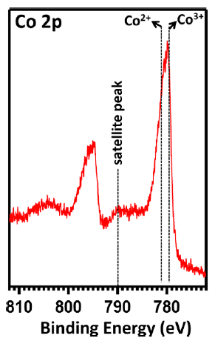
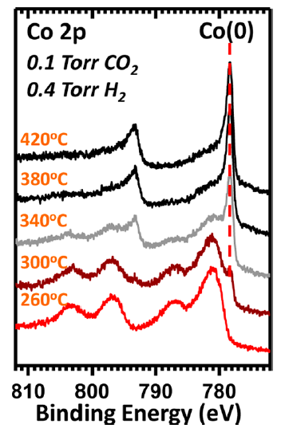
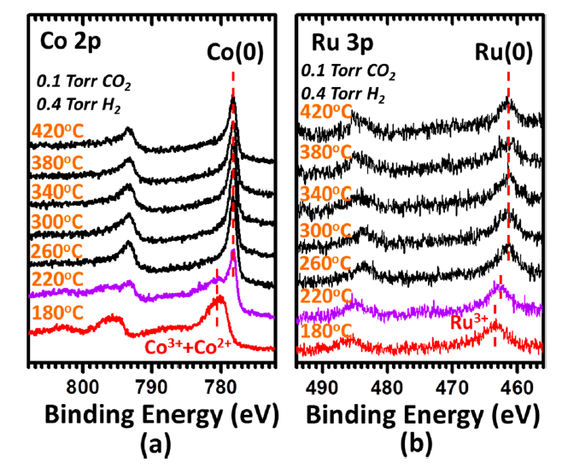
Applications
AP-XPS：Co₃O₄ only
AP-XPS: (Co_{0.95}Ru_{0.05})₃O₄
XPS
CoO
0.5 Torr CO₂+H₂
0.5 Torr CO₂+H₂
260℃
300℃
Ru³⁺
Ru(partial reduced )
Co₃O₄
CoO
Co(0)
220℃
boosted by Ru
Co₃O₄
Co(0)
No CH₄
CH₄ generated
CH₄ generated

Slide 15
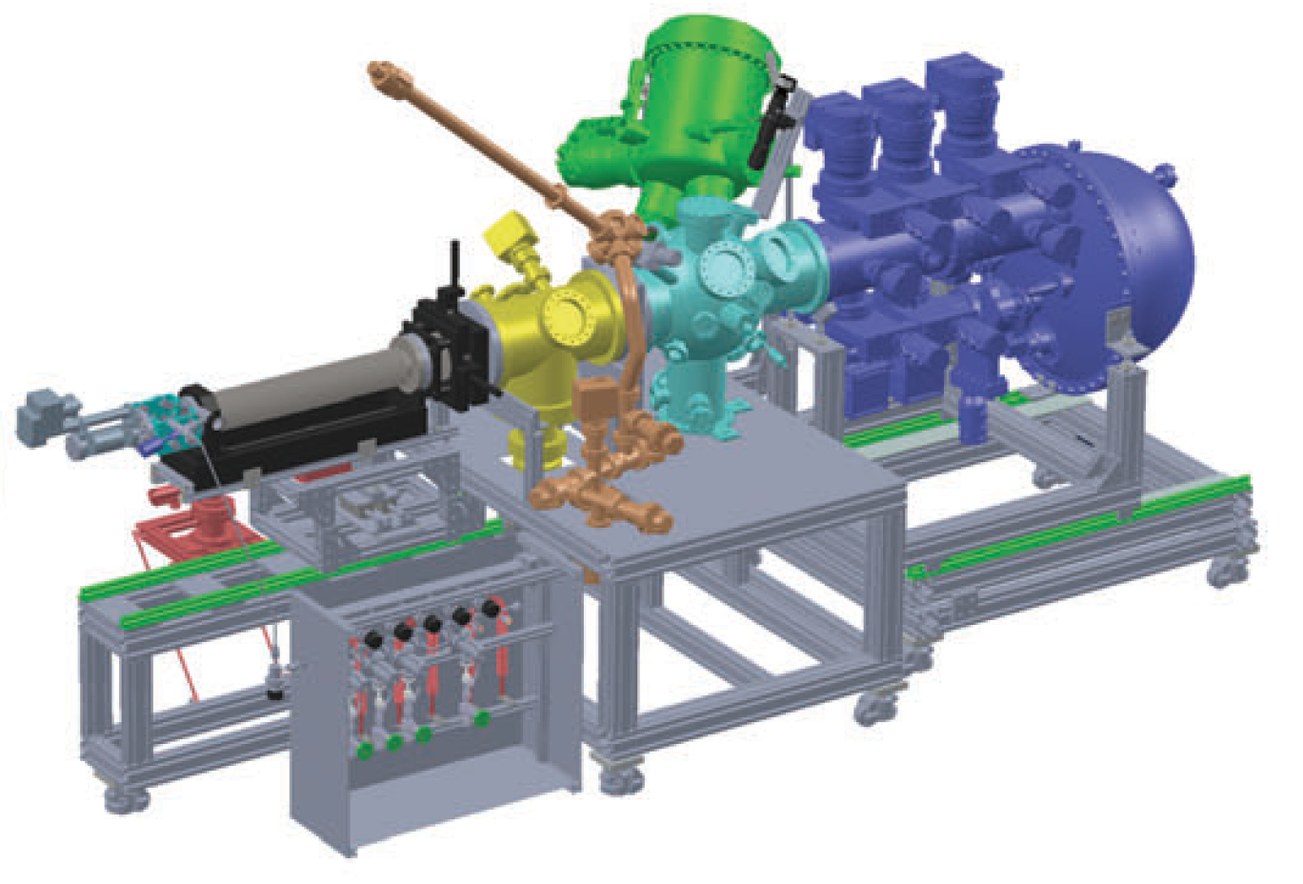
Summary
Binding energy of core level electrons can be obtained by XPS experiments, which is sensitive to change of electron states. Photoelectron detected by XPS detector has a mean free path lower than 10 nm, making XPS a powerful technique for surface analysis.
UHV is required for traditional XPS experiments. Results of UHV XPS measurements is not representative for real condition. AP-XPS use separated chamber and differential pumping system to perform test in near ambient pressure and different temperature, thus provide more real information.
Absorption, rearrangement of surface atom, change in coordinate number or form, all result in change of binding energy, which can be tested and analyzed by AP-XPS in real application.

Slide 16
References
[1] X. Bao*, et. al, Chem. Rev., 2019, 119, 12, 6822-6905.
[2] G. A. Somorjai*, et. al, Science, 2010, 327, 5967, 850-853. [3] Feng Tao*, et. al, ACS Catal. 2012, 2, 2403−2408
[4] M. Ammann*, et. al, Top Catal., 2016, 59, 591-604.
[5] J. A. van Bokhoven*, et. al, J. Phys. Chem. Lett., 2017, 8, 102-108.
[6] John T. Newberg*, et. al, Surf. Sci. Rep. 2018, 73, 37-57
[7] J. Frenken and I. Groot (eds.), Operando Research in Heterogeneous Catalysis,
Chapter 2, Springer Series in Chemical Physics 114, 2017.
[8] A. Jablonski, C.J. Powell, J. Electron. Spectrosc. 2015, 199, 27-37
[9] A. Kolmakov*, et. al, Nanoscale 2014, 6, 14394-14403
[10] M.B. Salmeron*, et. al J. Phys. Chem. Lett. 2016, 7, 1622–1627

Slide 17
致谢
感谢江颖老师的指导
感谢各位同学的讨论

